Slide 1

Python: Multiple Regression
Žydrūnė Kelpšaitė
Data Analyst
2026

Slide 2
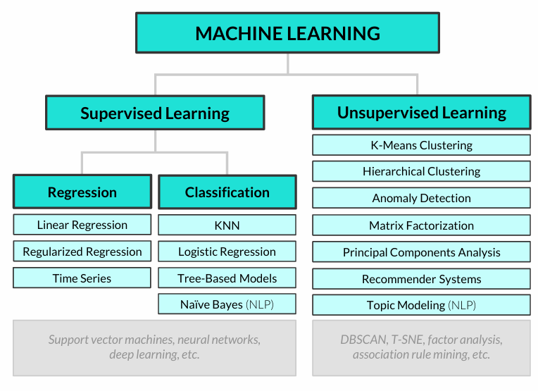
COMMON ALGORITHMS

Slide 3
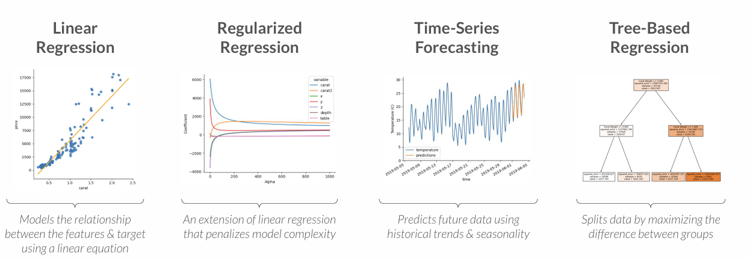
TYPES OF REGRESSION
These are some of the major types of regression modeling techniques
Even though logistic regression (which you may have heard of) has “regression” in its name, it’s actually a classification modeling technique!

Slide 4
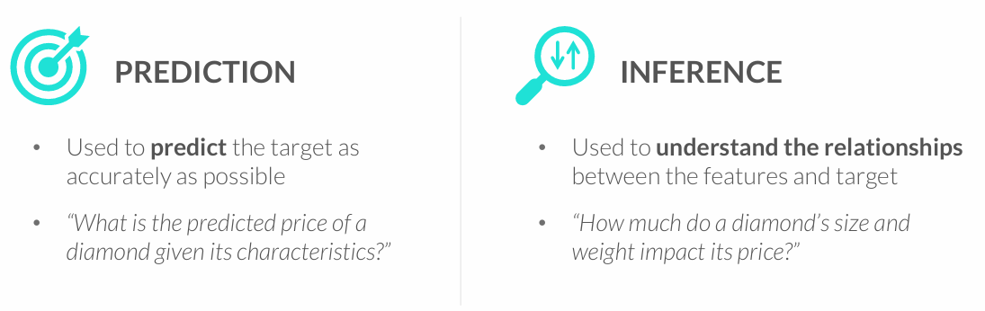
GOALS OF REGRESSION
Regression models are used for two primary goals: prediction and inference
• The goal shapes the modeling approach, including the regression algorithm used, the complexity of the model, and more
You often need to strike a balance between these goals – a model that is very inaccurate won’t be too trustworthy for inference, and understanding the impact that variables have on predictions can help make them more accurate

Slide 5
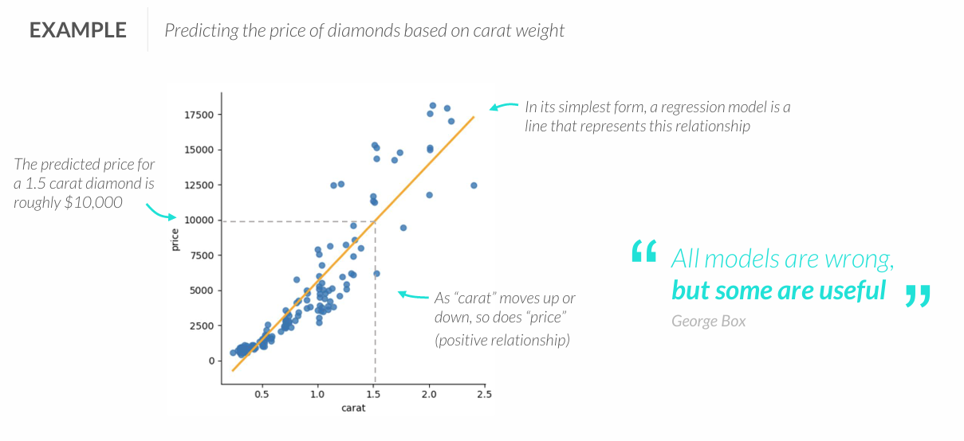
REGRESSION 101
Regression analysis is supervised learning technique used to predict a numeric variable (target) by modeling its relationship with a set of other variables (features)

Slide 6
REGRESSION 101
Regression analysis is supervised learning technique used to predict a numeric variable (target) by modeling its relationship with a set of other variables (features)

Slide 7
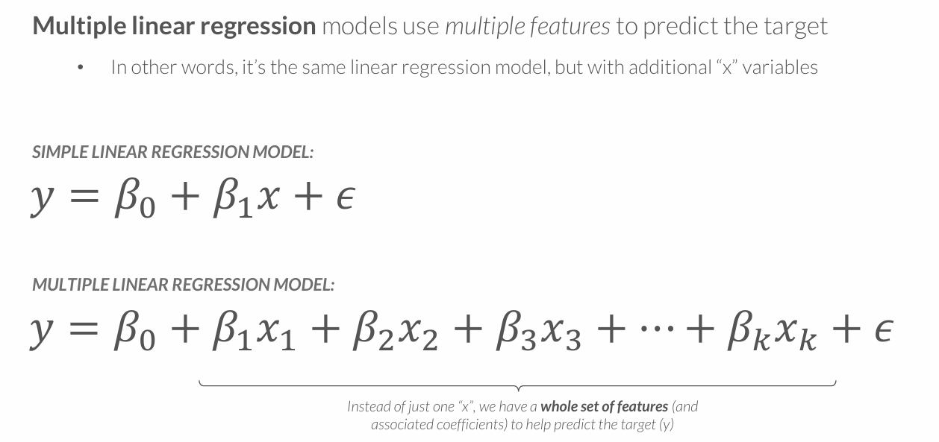
MULTIPLE LINEAR REGRESSION

Slide 8
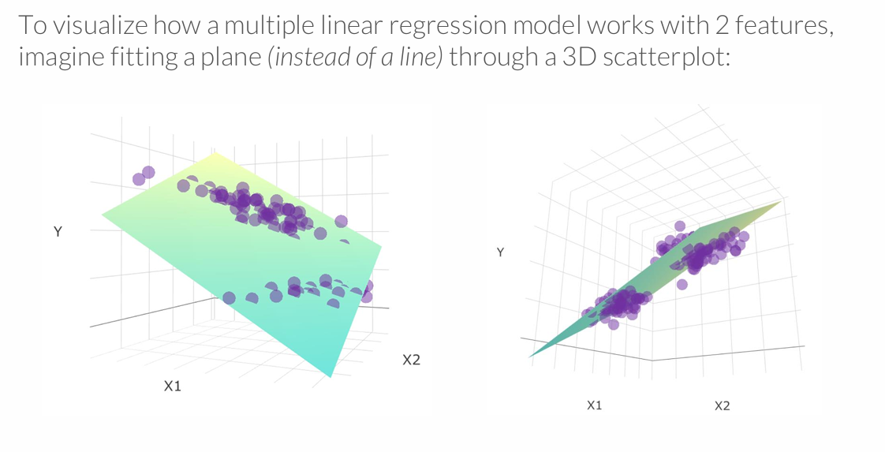
MULTIPLE LINEAR REGRESSION MODEL
Multiple regression can scale well beyond 2 variables, but this is where visual analysis breaks down – and one reason why we need machine learning!

Slide 9
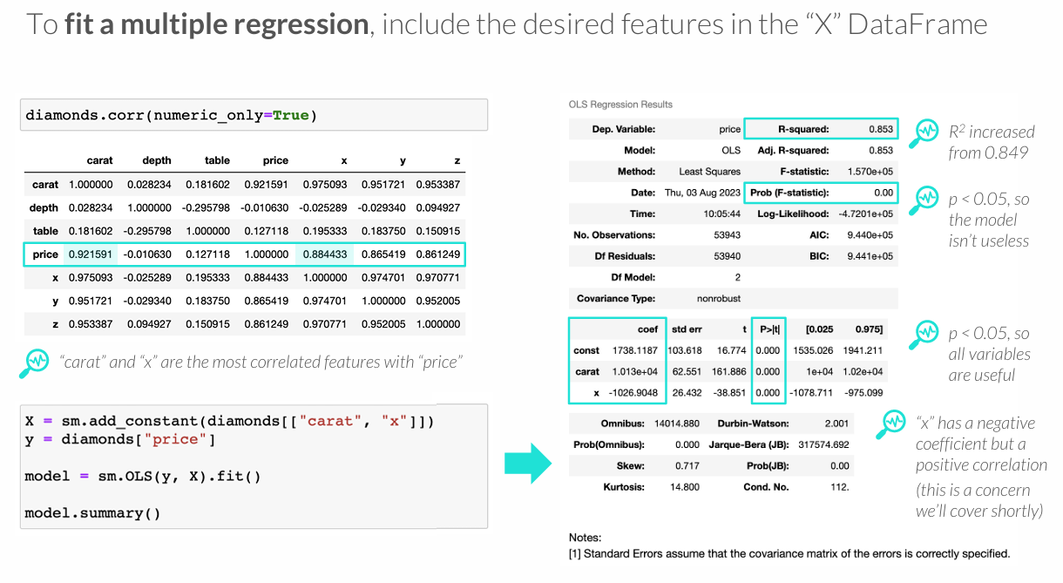
FITTING A MULTIPLE REGRESSION

Slide 10
MODEL ASSUMPTIONS

Slide 11
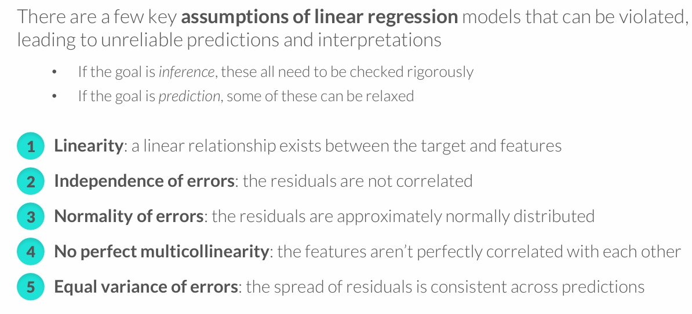
ASSUMPTIONS OF LINEAR REGRESSION

Slide 12
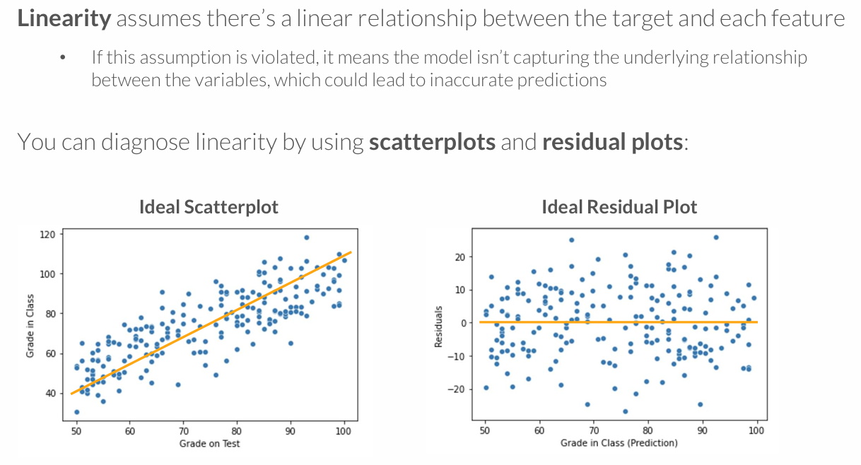
LINEARITY

Slide 13
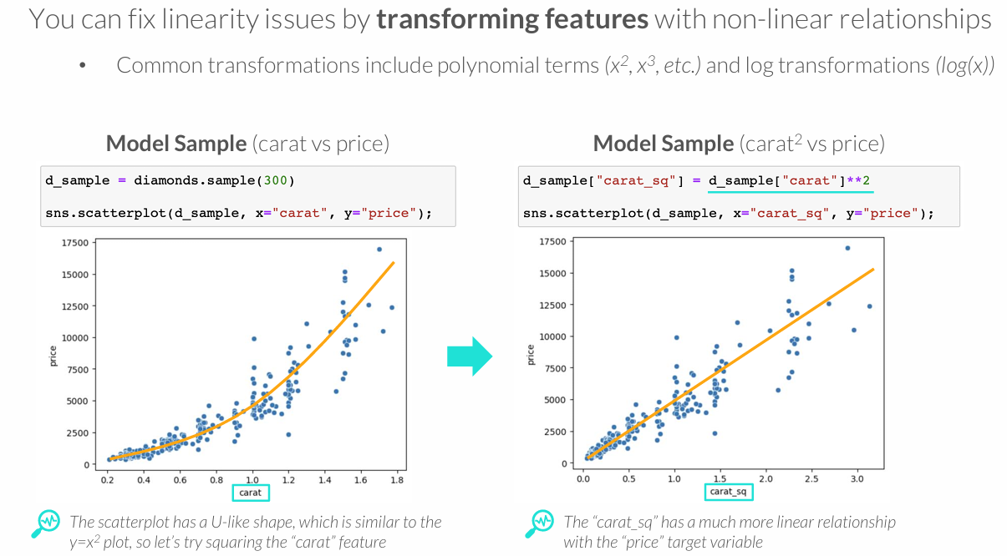
LINEARITY

Slide 14
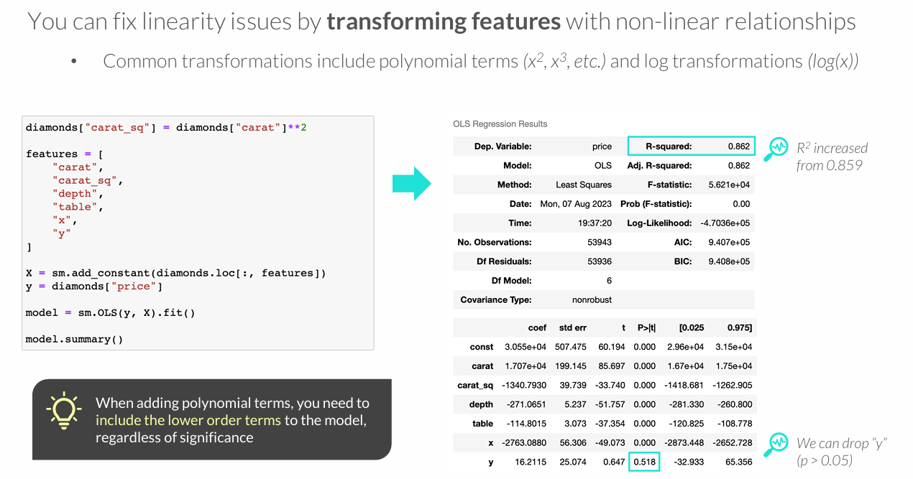
LINEARITY

Slide 15
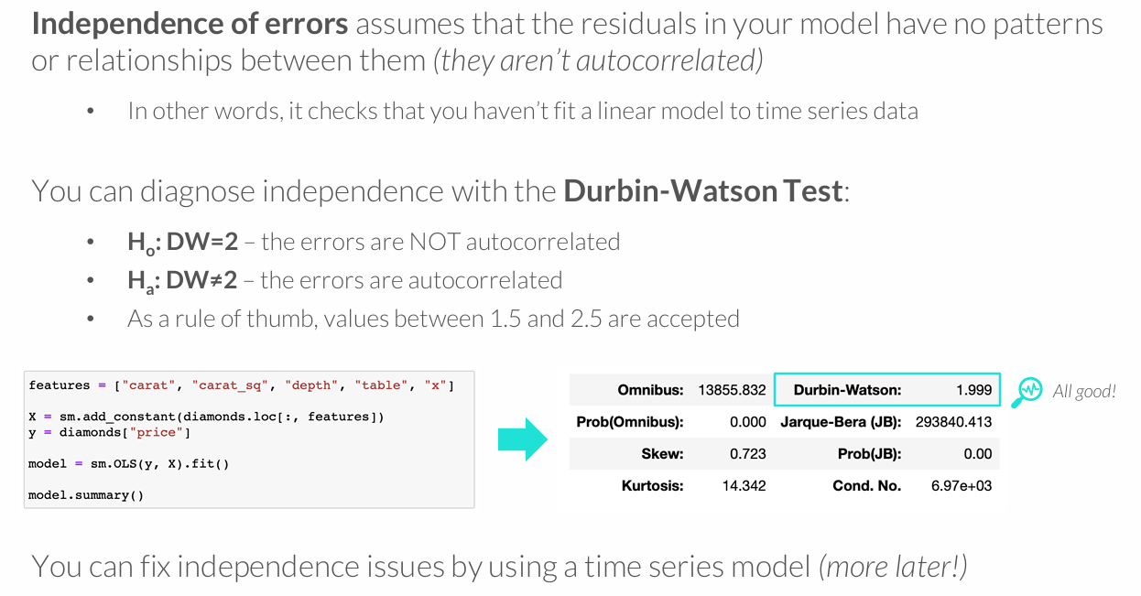
INDEPENDENCE OF ERRORS

Slide 16
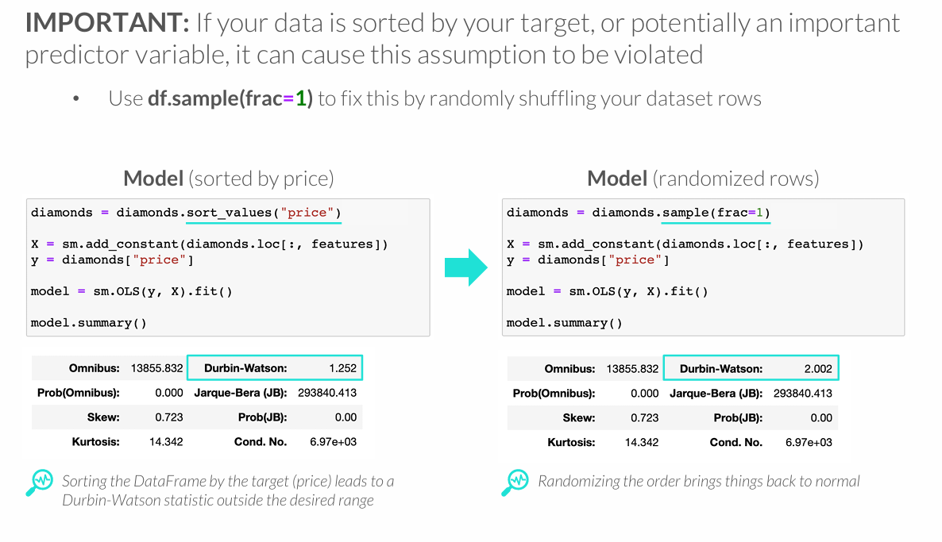
INDEPENDENCE OF ERRORS

Slide 17
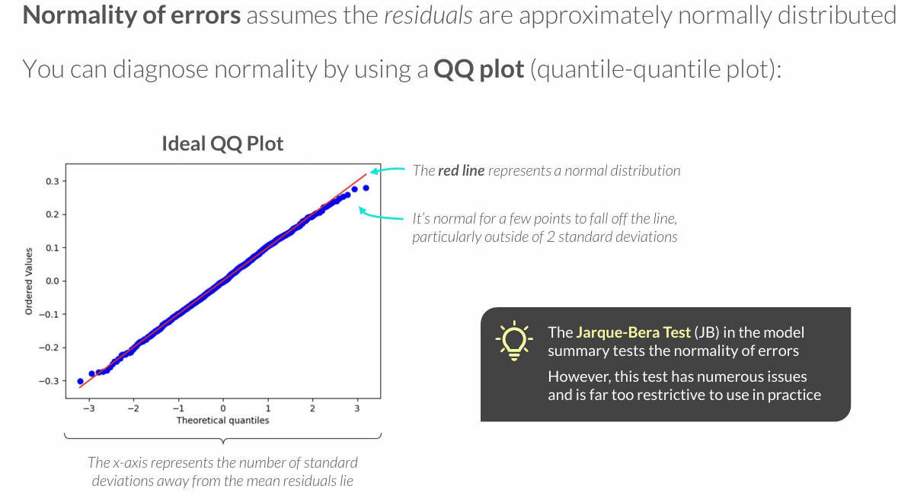
NORMALITY OF ERRORS

Slide 18
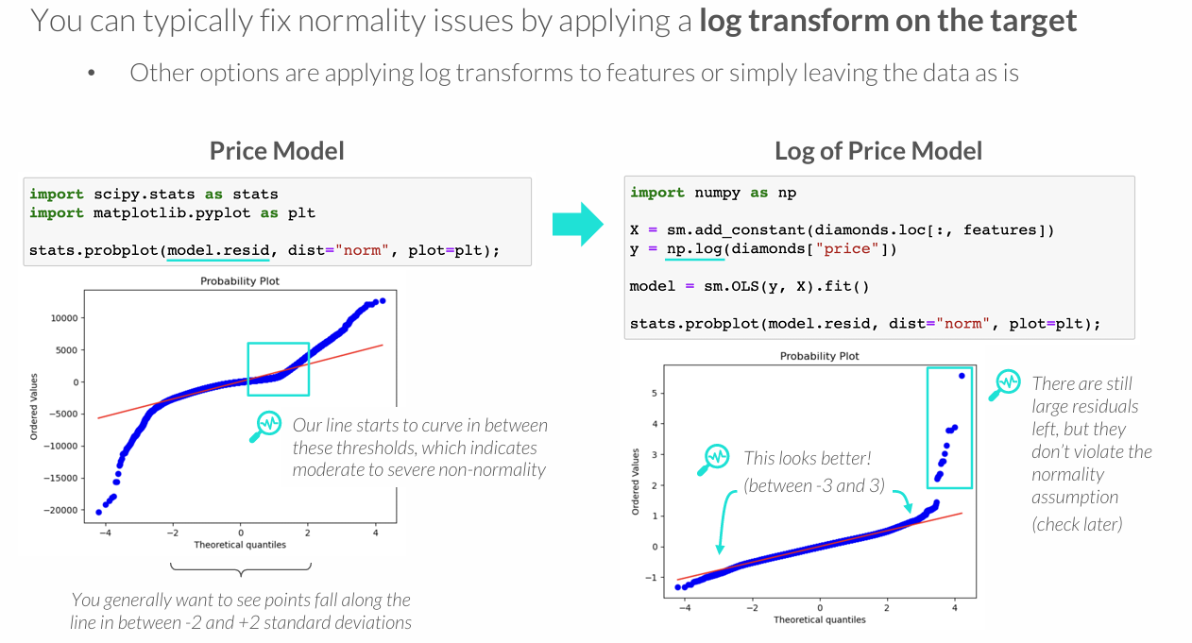
NORMALITY OF ERRORS

Slide 19
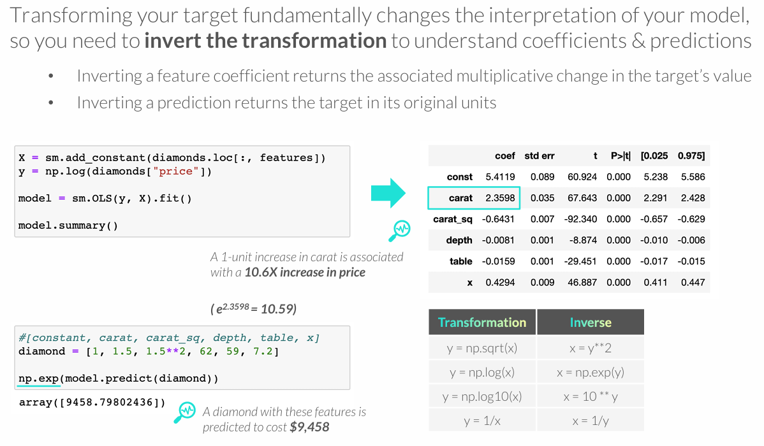
PRO TIP: INTERPRETING TRANSFORMED TARGETS
Notes:
Naudoti exp()

Slide 20
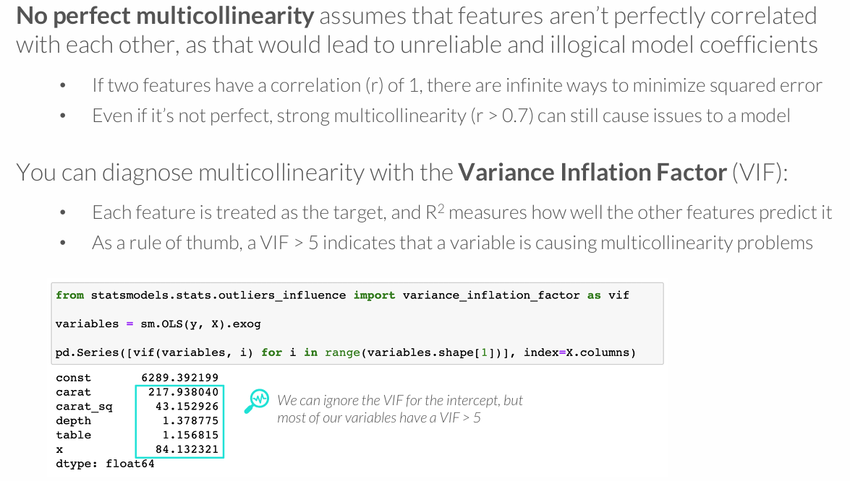
NO PERFECT MULTICOLLINEARITY

Slide 21
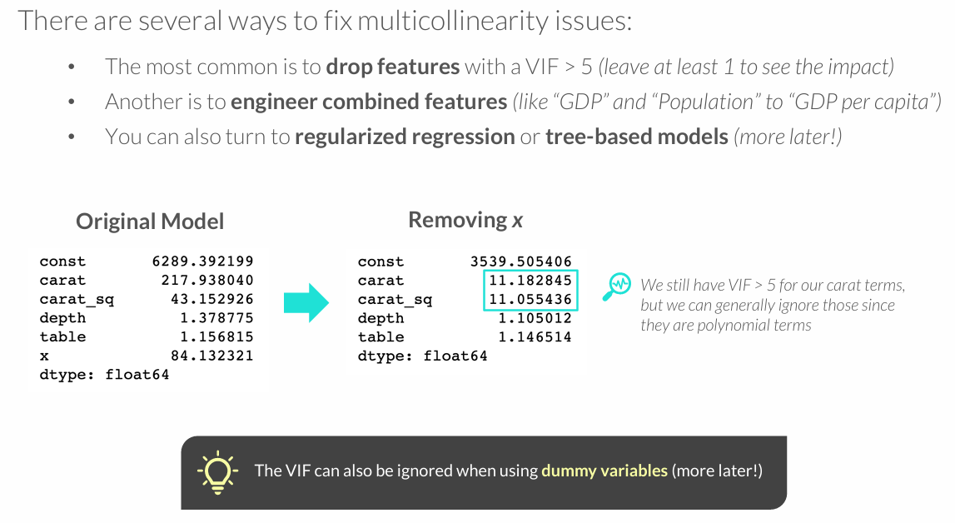
NO PERFECT MULTICOLLINEARITY

Slide 22
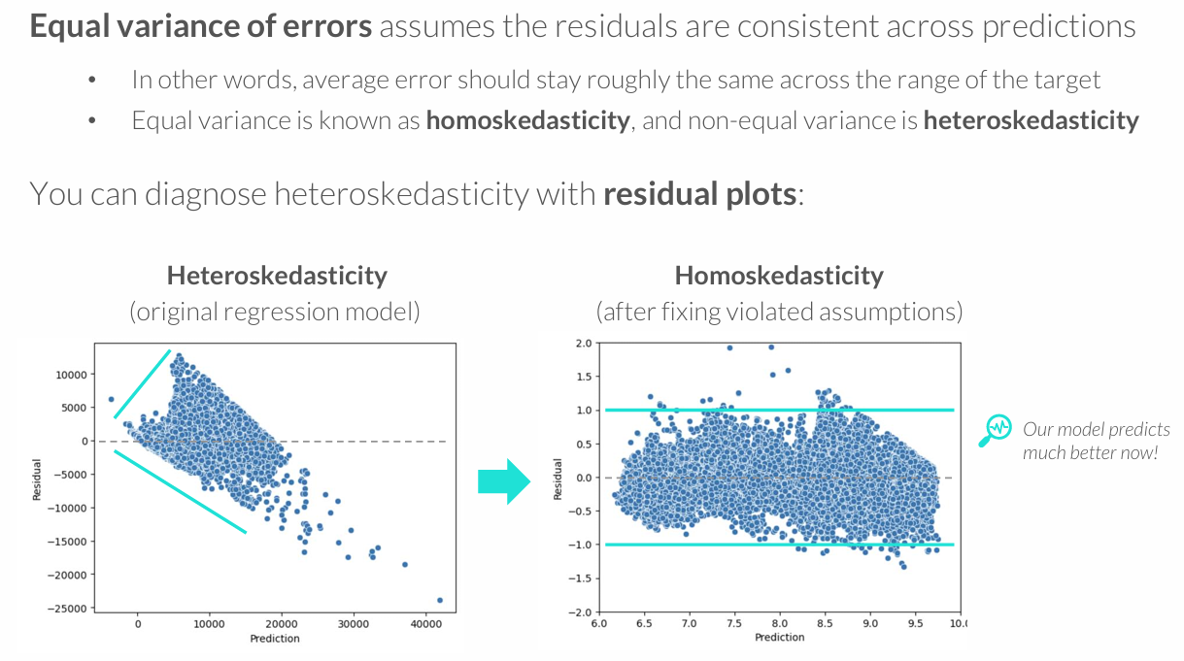
EQUAL VARIANCE OF ERRORS

Slide 23
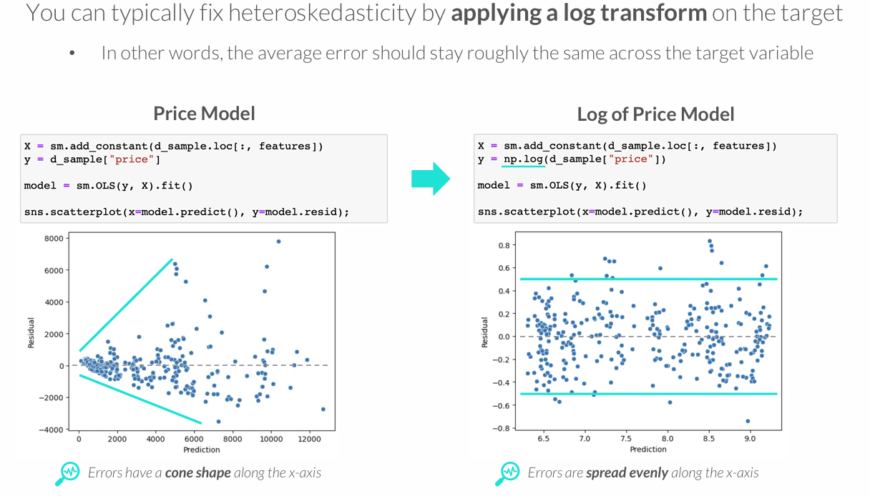
EQUAL VARIANCE OF ERRORS

Slide 24
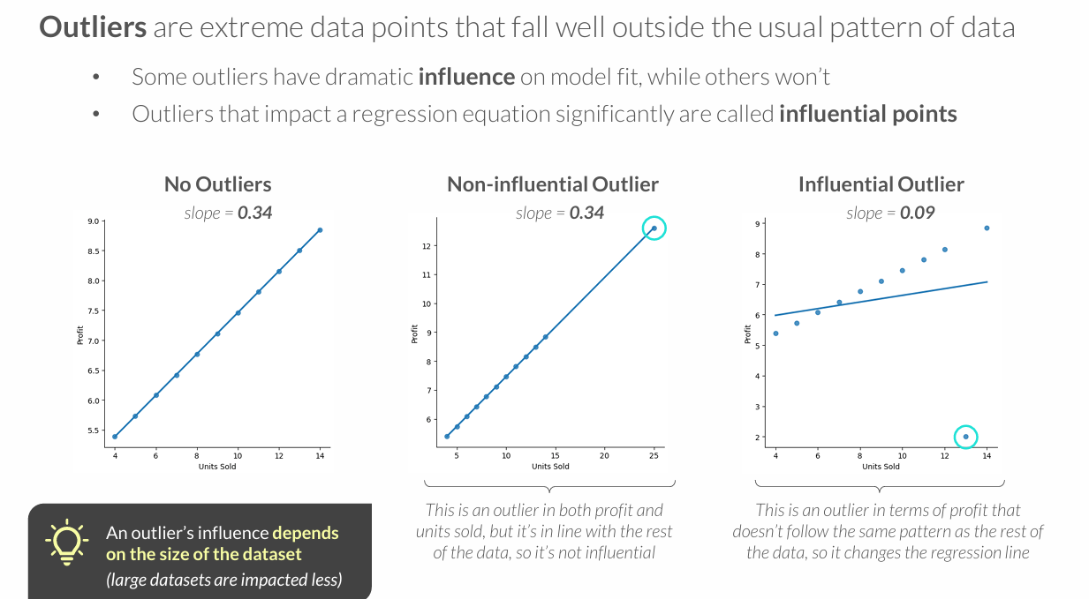
OUTLIERS & INFLUENCE

Slide 25
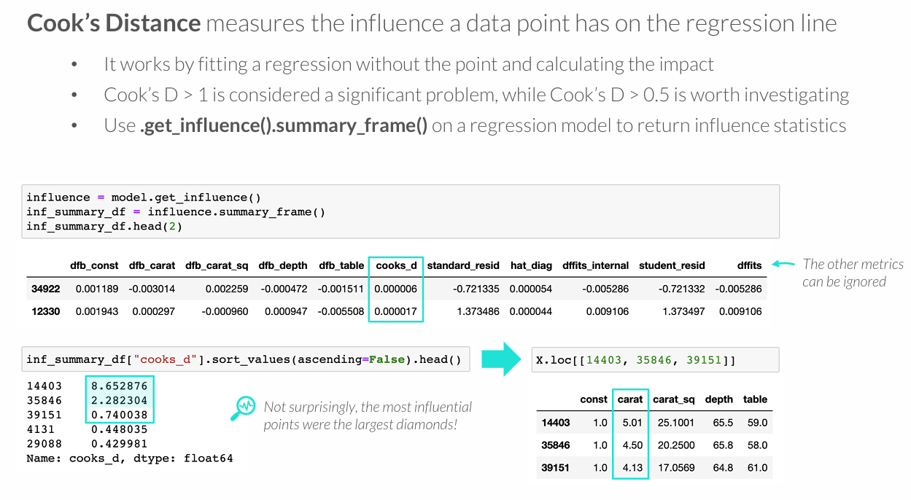
OUTLIERS & INFLUENCE

Slide 26
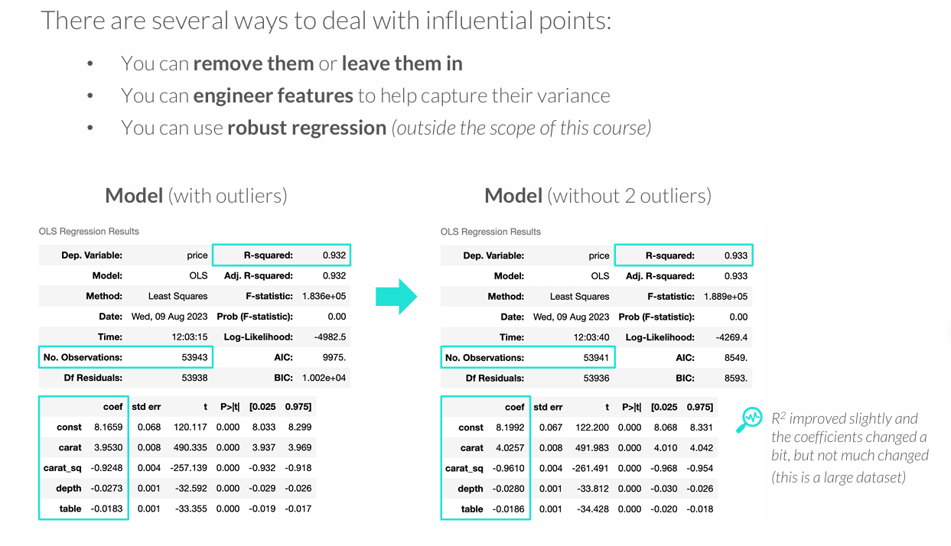
OUTLIERS & INFLUENCE

Slide 27
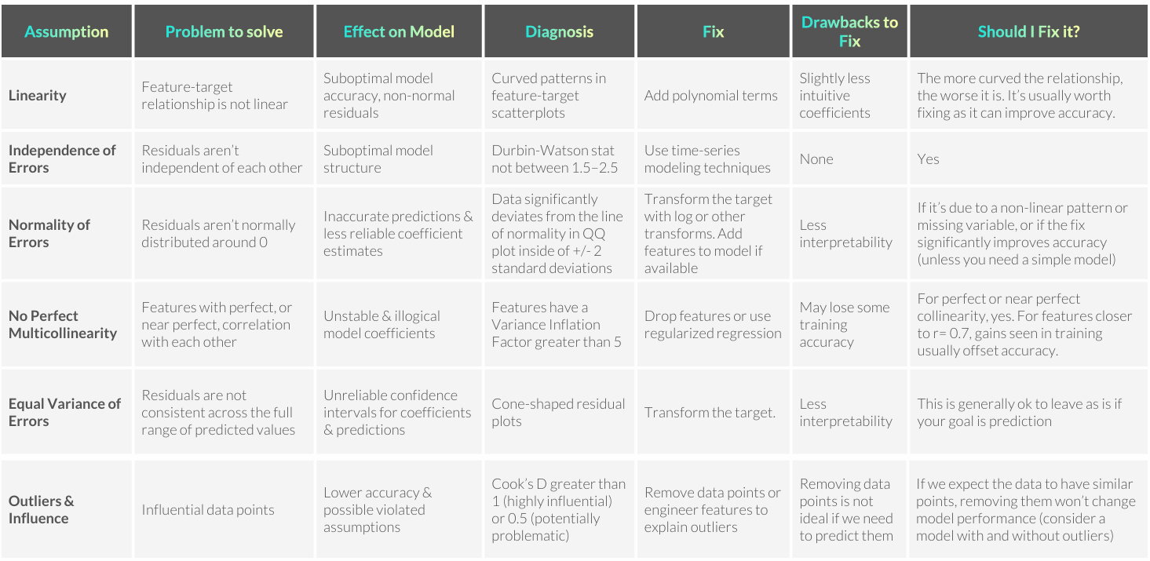

Slide 28
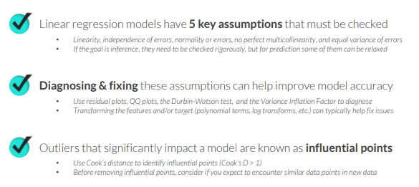
Key Take Aways

